Slide 1
Quantitative Research Methods in Climate Change and Sustainability Science
Nguyen Bich Ngoc
VNU School of Interdisciplinary Studies
Notes:
Giới thiệu bản than
Yêu cầu học viên tự giới thiệu
Background ngành gì
Định hướng/kinh nghiệm nghiên cứu thực nghiệm/observational

Slide 2
Practical Information
Theoretical session: Sunday 23/04 & Sunday 07/05/2023 morning
Practical session: Sunday 07/05/2023 afternoon
R
Laptop with R & RStudio installed
Exam:
Exercises: 07/05/2023
Oral exam: 10 minutes on 20-23/05/2023 (MS Teams/Zoom)

Slide 3
Expected outcomes
Focus on applied statistics
Basic concepts/theory
Identify problems and corresponding solutions (names)
Research: Why, what, & how?

Slide 4
Recommended readings
Applied statistics with R – David Dalpiaz (https://book.stat420.org/)
Cẩm nang nghiên cứu khoa học: từ ý tưởng đến công bố – Nguyễn Văn Tuấn (2nd edition, 2020)
Từng bước nhập môn nghiên cứu khoa học xã hội – Phạm Hiệp & cộng sự (2022)
Research design: qualitative, quantitative, and mixed methods approaches – John W. Creswell & J. David Creswell (5th edition, 2018)
Fundamentals of data visualization – Claus O. Wilke (https://clauswilke.com/dataviz/index.html)
Introduction to quantitative research methods: an investigative approach – Mark Balnaves and Peter Caputi (2001)

Slide 5
Content
Research: why, what, & how?
What is data and how to collect?
Data plotting and cleaning
Descriptive statistics
Inferential statistics
Advanced topics in quantitative methods

Slide 6
Research: Why, what, & how?

Slide 7


Why?
Research: Why, what, & how?

Slide 8
What?
Research: Why, what, & how?

Slide 9
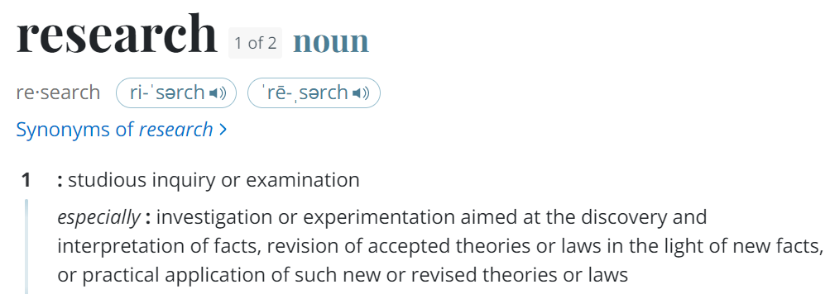
What?
(Merriam-Webster Dictionary)
Quantitative research is an approach for testing objective theories by examining the relationship among variables. These variables, in turn, can be measured, typically on instruments, so that numbered data can be analyzed using statistical procedures.
(John W. Creswel)
Research: Why, what, & how?

Slide 10
How?
Research: Why, what, & how?

Slide 11
How?
Identify research questions (novel?, relevant?, feasible?)
Design research (Experimental/Observational)
Collect/Generate data
Analyze data & draw conclusion
Communicate results
Research: Why, what, & how?

Slide 12
How?
Identify research questions (novel?, relevant?, feasible?)
Design research (Experimental/Observational)
Collect/Generate data
Analyze data & draw conclusions
Communicate results
Research: Why, what, & how?

Slide 13
What is data and how to collect?
Data, Variables, Distributions
Sample and Sampling methods
Survey design
Experimental design

Slide 14
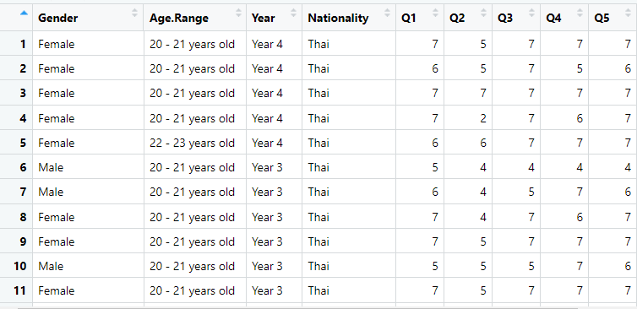
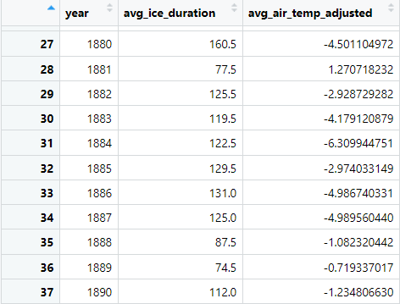
Data
Variables
Observations/Units
What is data and how to collect?

Slide 15
Variables
Levels of measurement
Nominal, Ordinal, Interval, Ratio
Possible received values
Categorical, Discrete, Continuous
Relationships
Independent/Explanatory, Dependent/Outcome, Controlled
What is data and how to collect?

Slide 16
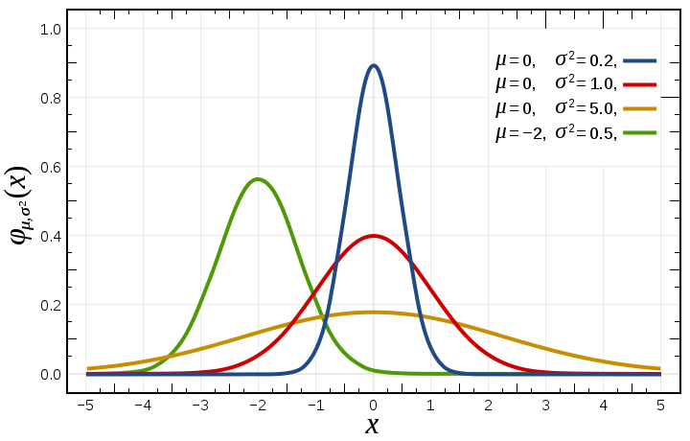
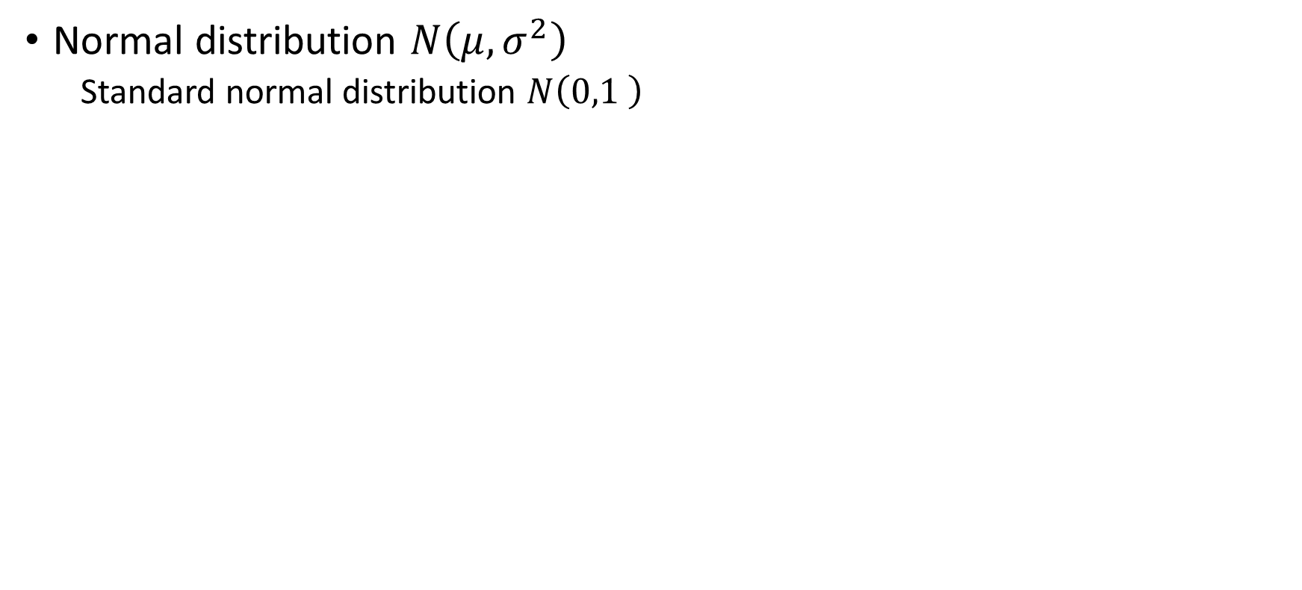
Common distributions
Normal distribution $N\left(μ,σ^{2}\right)$
Standard normal distribution $N\left(0,1 \right)$
What is data and how to collect?

Slide 17
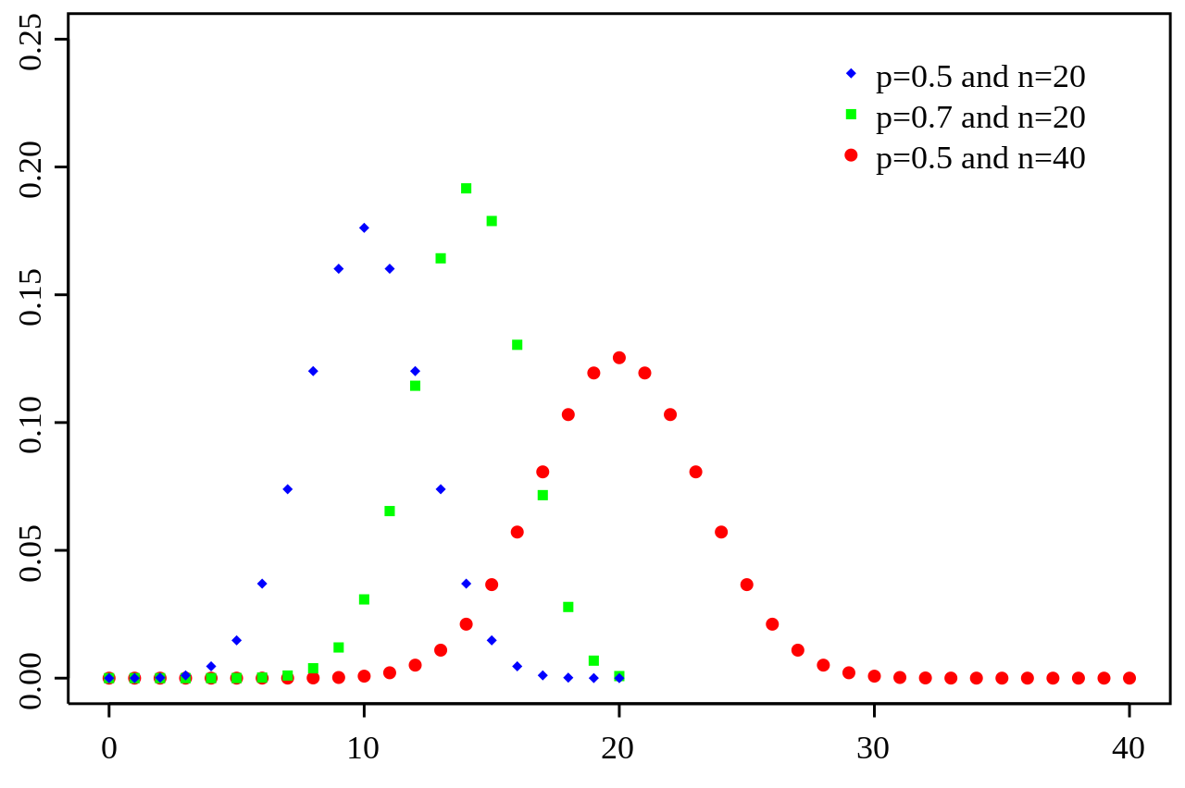
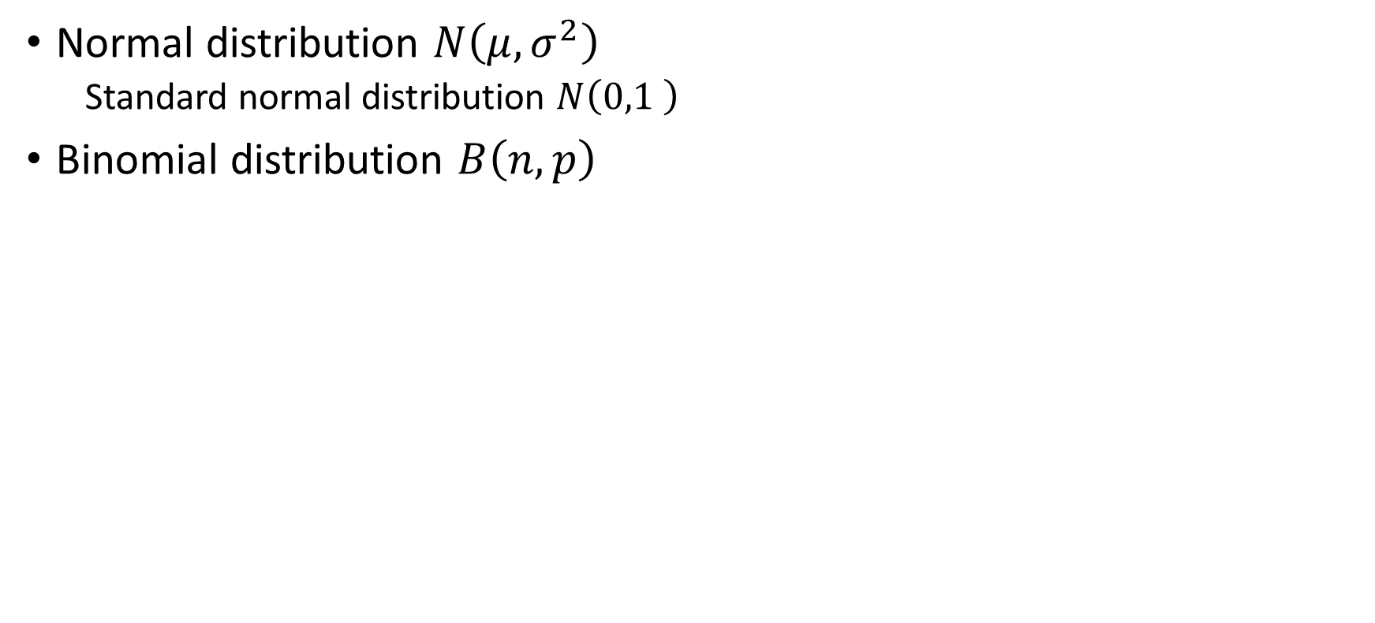
Common distributions
Normal distribution $N\left(μ,σ^{2}\right)$
Standard normal distribution $N\left(0,1 \right)$
Binomial distribution $B\left(n,p\right)$
What is data and how to collect?

Slide 18
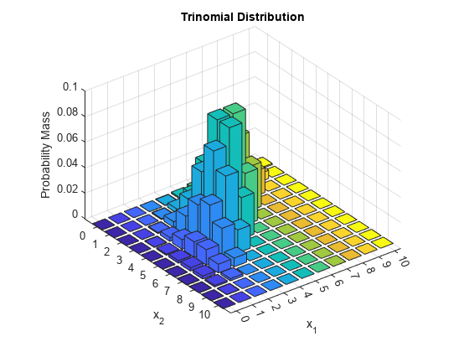
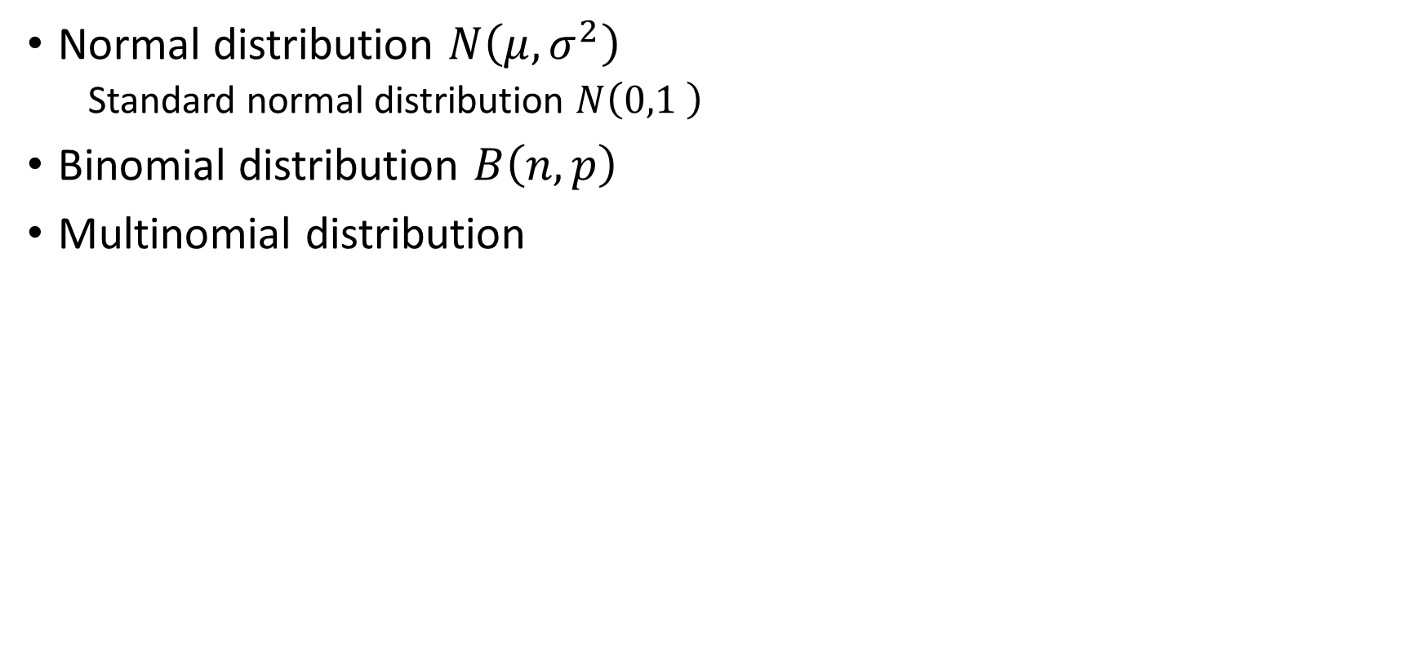
Common distributions
Normal distribution $N\left(μ,σ^{2}\right)$
Standard normal distribution $N\left(0,1 \right)$
Binomial distribution $B\left(n,p\right)$
Multinomial distribution
What is data and how to collect?

Slide 19
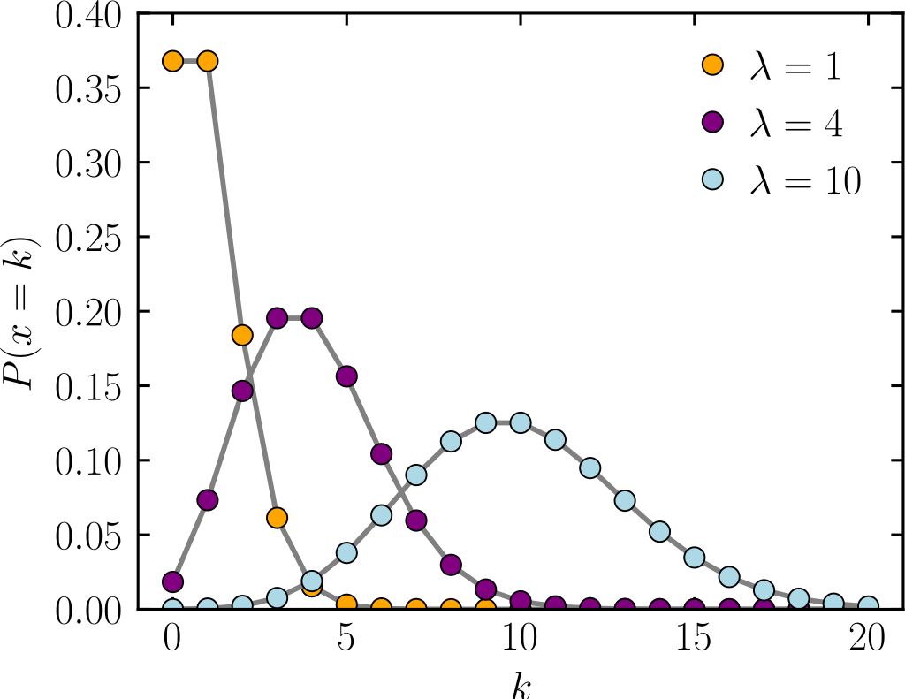
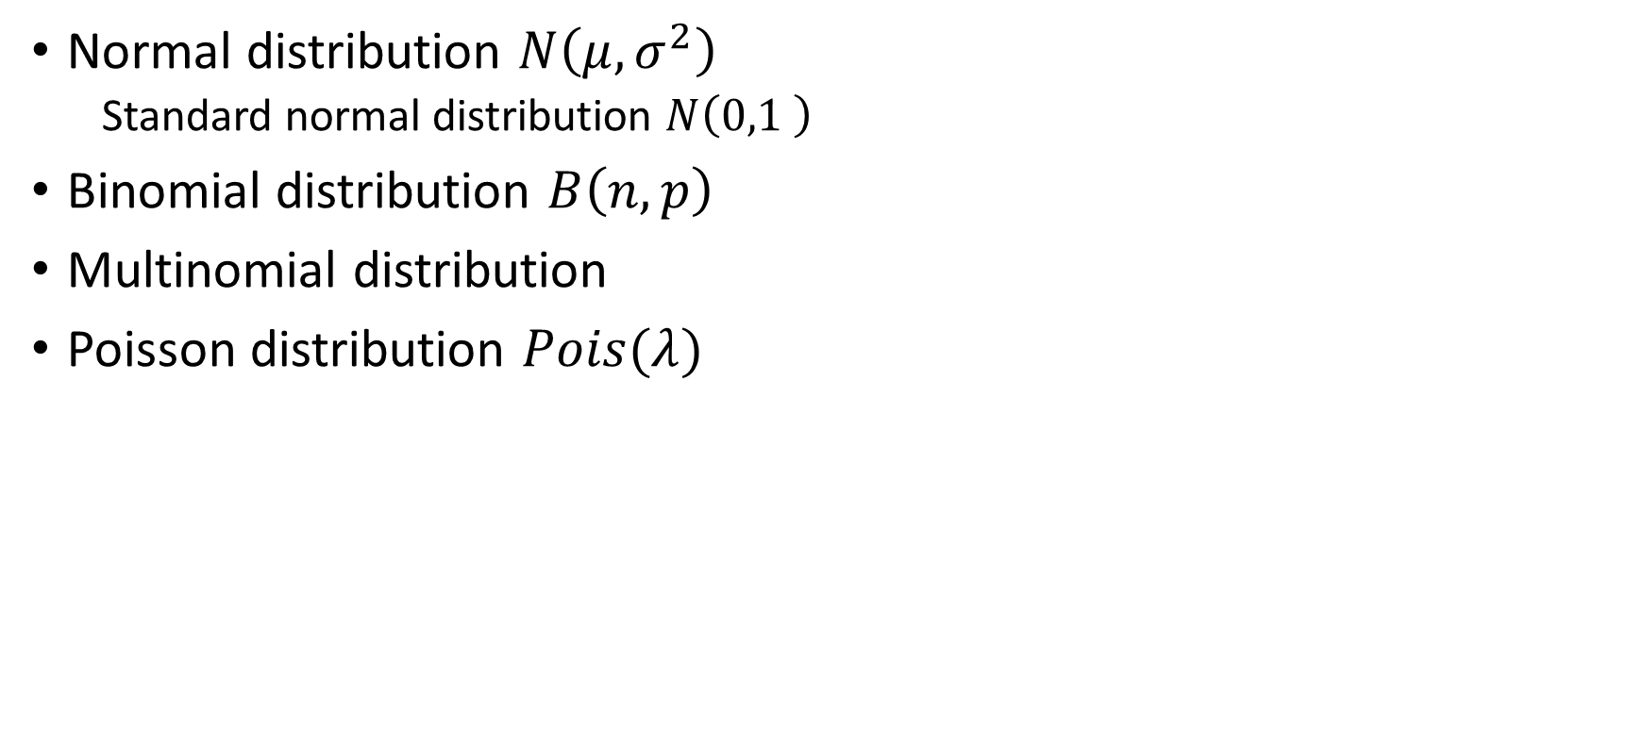
Common distributions
Normal distribution $N\left(μ,σ^{2}\right)$
Standard normal distribution $N\left(0,1 \right)$
Binomial distribution $B\left(n,p\right)$
Multinomial distribution
Poisson distribution $Pois(λ)$
What is data and how to collect?

Slide 20
Data sources
Primary
Experiment
Survey/questionnaire
Observation/Measurement
Secondary
Open-source database
Government publications
Internal reports
What is data and how to collect?

Slide 21
Sample and sampling methods
Sub-population
Representative?
Sample size
Too small?
Too large?
What is data and how to collect?

Slide 22
Sample and sampling methods
Sampling methods
Probability sampling
Simple random sampling
Systematic sampling
Stratified sampling
Cluster sampling
Non-probability sampling
Convenience sampling
Quota sampling
Judgement (or purposive) sampling
Snowball sampling
What is data and how to collect?
Notes:
Representative?

Slide 23
Survey design
Constructs of interest
What?
How to measure?
Questionnaires design
Wording
Use of single question
Cognitive processes in answering questions
PRETEST survey questions
What is data and how to collect?
Notes:
W
Two similar questions ?
Do you think global warming is a major problem? Yes/No or DK
Do you think climate change is a major problem? Yes/No or DK
Avoid leading questions
Recall process – time frame
e.g. Did you recycle in the last week/last year?

Slide 24
Survey design
Targeted population
Coverage errors
Constructs
Sampling frame
Validity
Sampling errors
Measurements
Sample
Measurement errors
Nonresponse errors
Responses
Respondents
Processing
errors
Adjustment errors
Edited responses
Postsurvey adjustments
Survey statistics
What is data and how to collect?

Slide 25
Data plotting and cleaning
Common plots
Plotting as tool for data cleaning

Slide 26
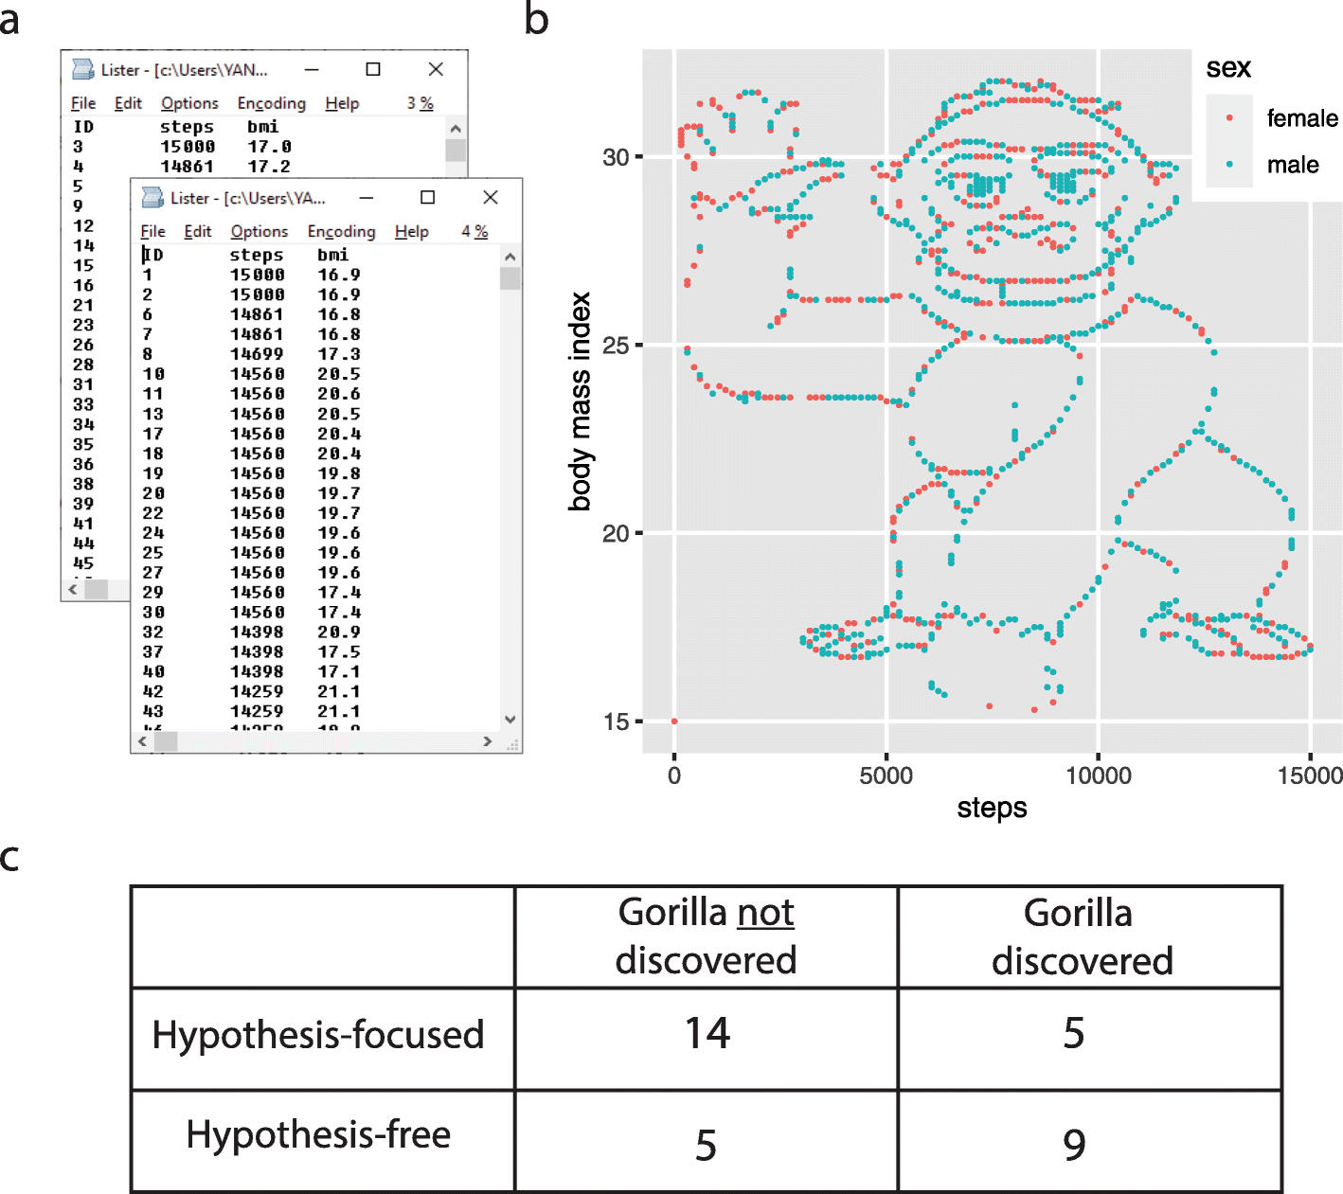
Yanai, I., Lercher, M. A hypothesis is a liability. Genome Biol 21, 231 (2020). https://doi.org/10.1186/s13059-020-02133-w
Data plotting and cleaning

Slide 27
Yanai, I., Lercher, M. A hypothesis is a liability. Genome Biol 21, 231 (2020). https://doi.org/10.1186/s13059-020-02133-w
Data plotting and cleaning

Slide 28
Yanai, I., Lercher, M. A hypothesis is a liability. Genome Biol 21, 231 (2020). https://doi.org/10.1186/s13059-020-02133-w
Data plotting and cleaning

Slide 29
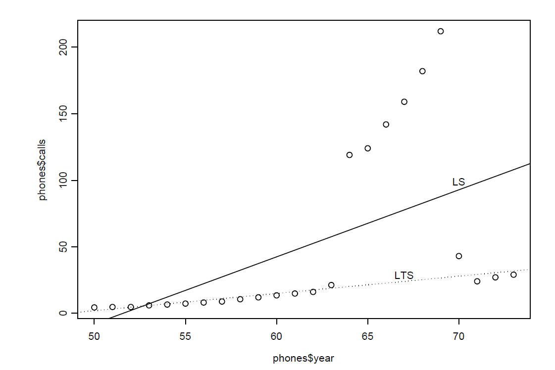
Telephone data
Calls (in millions) from Belgium in the years 1950-1973.
Data plotting and cleaning

Slide 30
Data plotting/visualization
Clarity
Precision
Efficiency
Maximize ideas, minimize ink
https://www.ted.com/talks/hans_rosling_the_best_stats_you_ve_ever_seen
Data plotting and cleaning

Slide 31
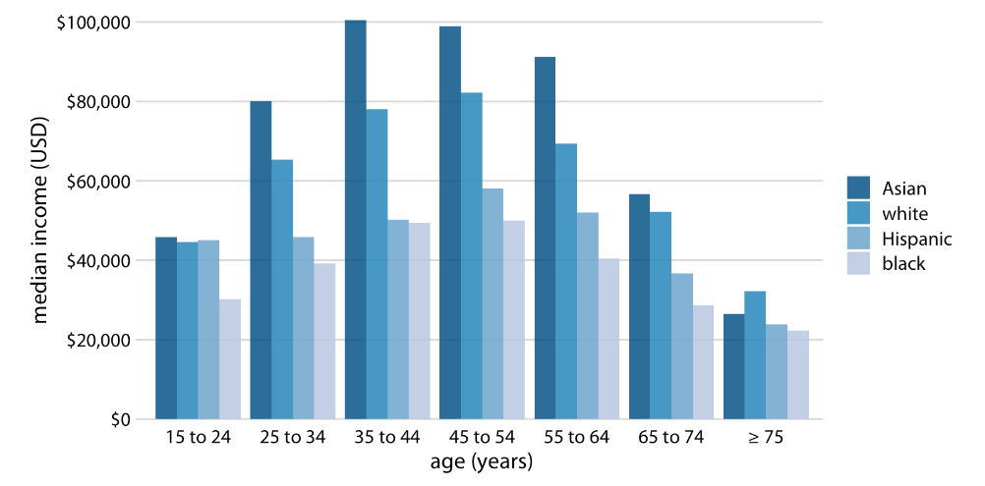
Commonly used plots
Wilke (2018)
Data plotting and cleaning

Slide 32
Commonly used plots
Data plotting and cleaning

Slide 33
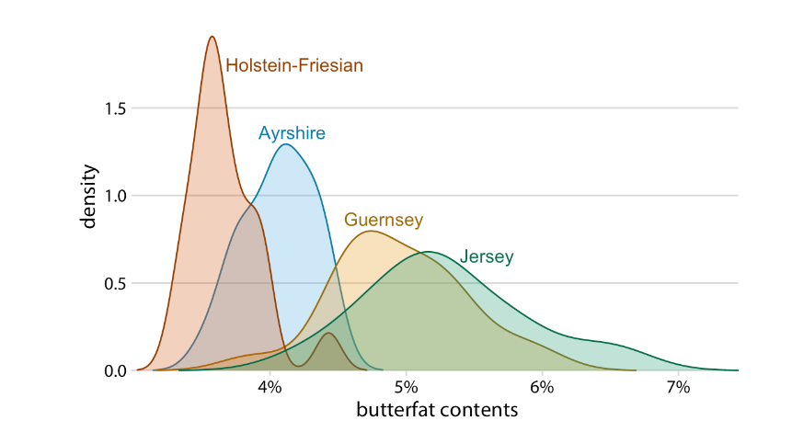
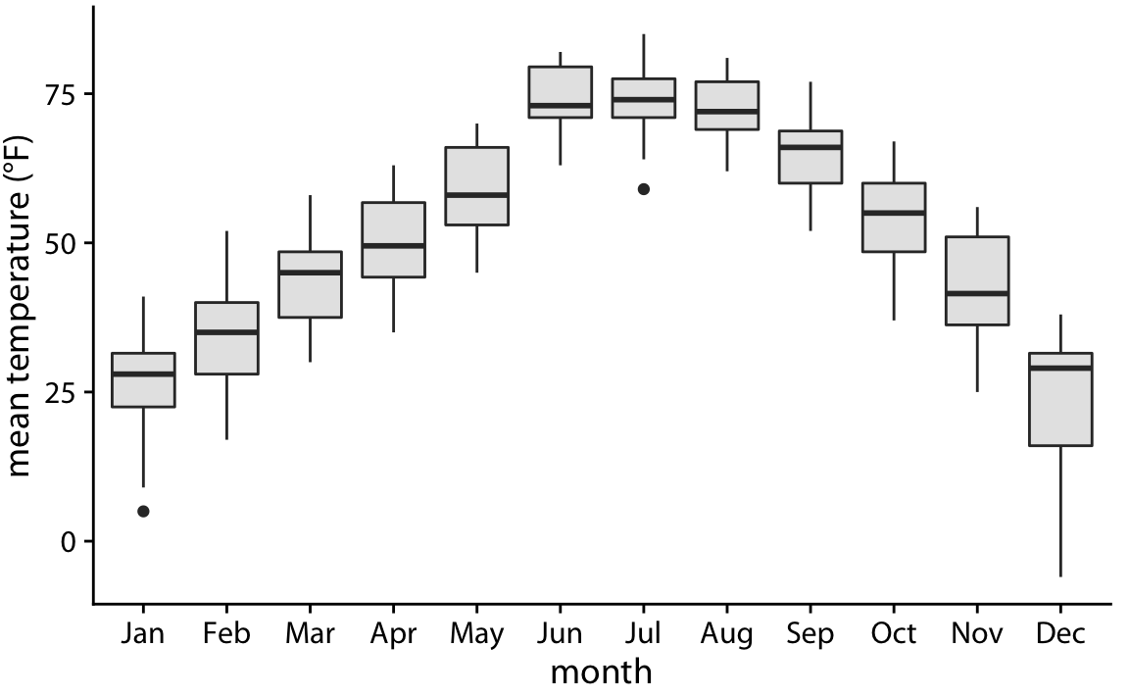
Commonly used plots
Wilke (2018)
Wilke (2018)
Data plotting and cleaning

Slide 34
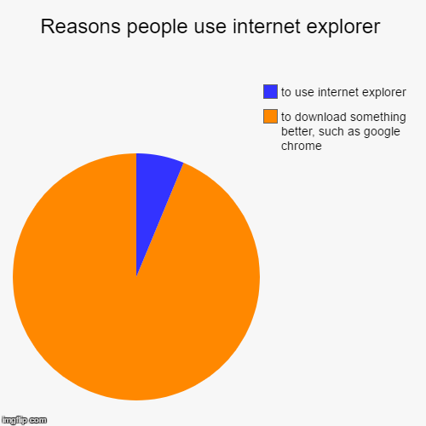
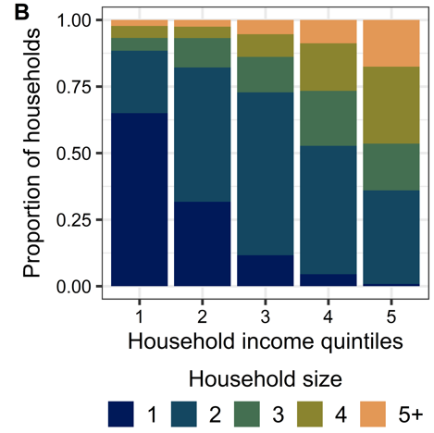
Commonly used plots
Data plotting and cleaning

Slide 35
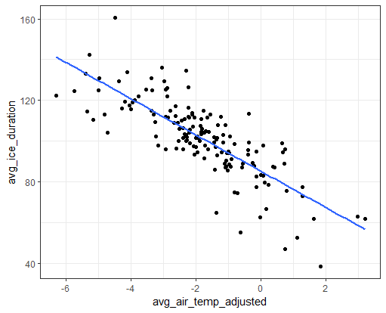
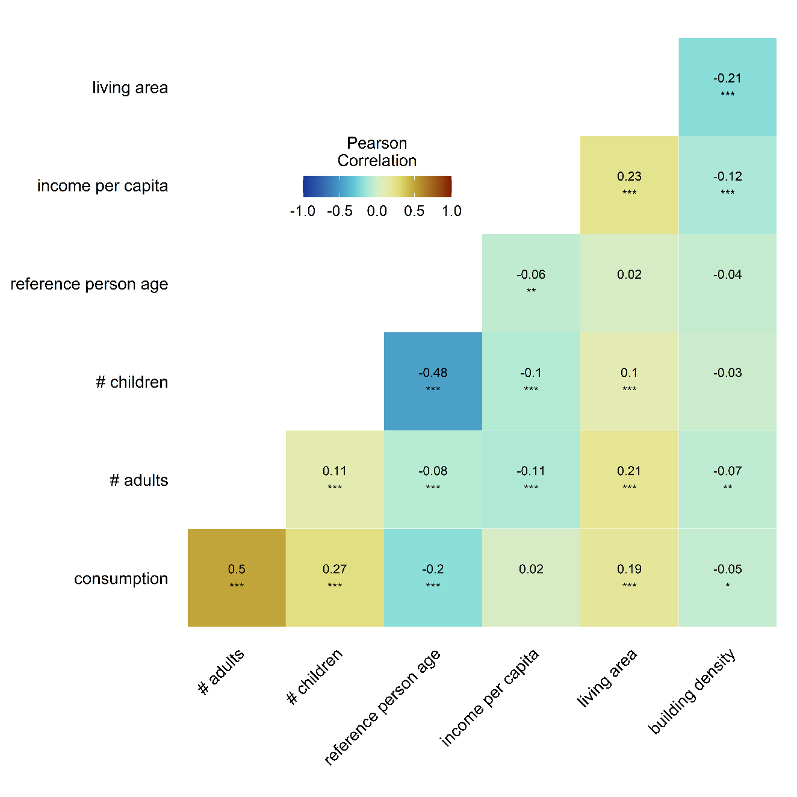
Commonly used plots
Data plotting and cleaning

Slide 36
Commonly used plots
Data plotting and cleaning

Slide 37
Descriptive statistics
Univariable
Bivariable

Slide 38
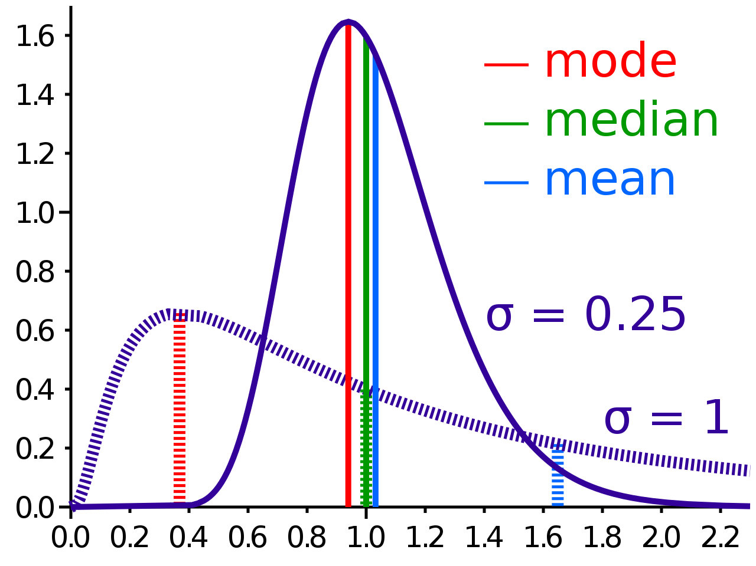
Mean, median, mode
This Photo by Unknown Author is licensed under CC BY-SA
Descriptive statistics

Slide 39
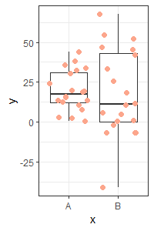
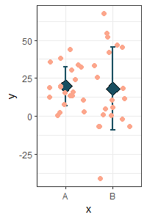
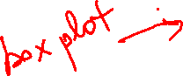
Dispersion
Descriptive statistics

Slide 40
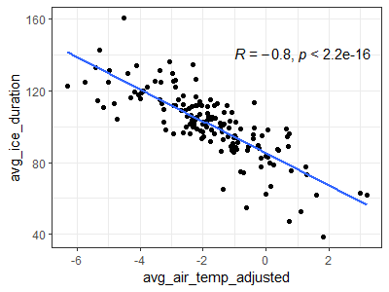
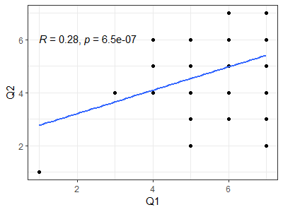
Associations
Pearson
Spearman
Notes:
Column I Question 1 In my opinion, it is important to protect the environment.
Column J Question 2 I actively practice environmental sustainability at home (e.g., energy conservation, recycling)

Slide 41
Associations
Notes:
Column I Question 1 In my opinion, it is important to protect the environment.
Column J Question 2 I actively practice environmental sustainability at home (e.g., energy conservation, recycling)

Slide 42
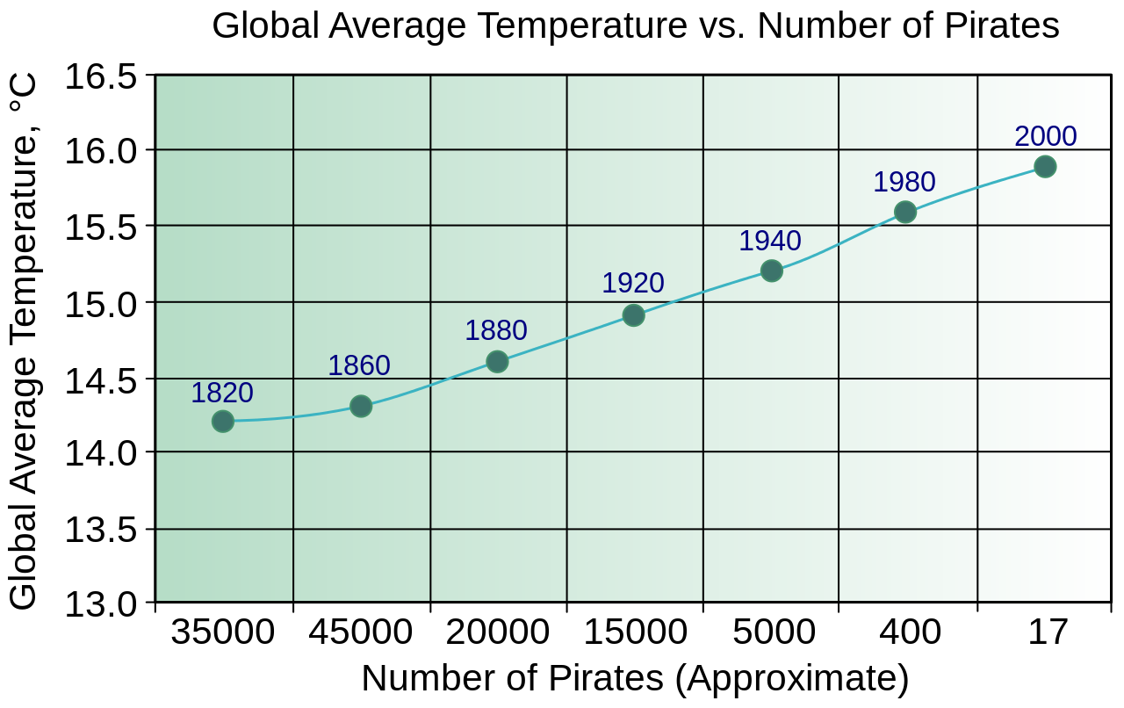
Correlation vs Causality
Descriptive statistics

Slide 43
Inferential statistics
Simple linear regression
General linear regression

Slide 44

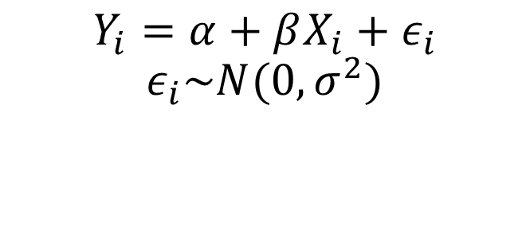



Simple linear regression
$$ε_{i}$$
$$α$$
$$Y_{i}=α+βX_{i}+ε_{i}$$
$$ε_{i}\sim N(0,σ^{2})$$
$$β$$
Inferential statistics

Slide 45
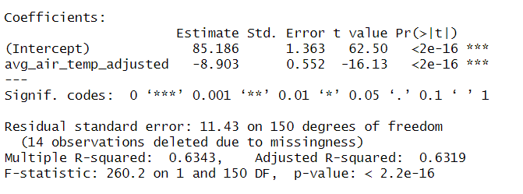
Simple linear regression
Inferential statistics

Slide 46
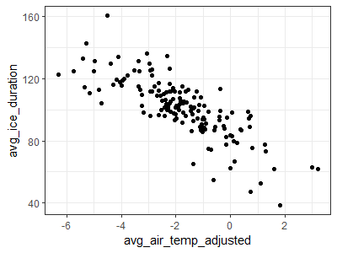
Simple linear regression
Which one?
Inferential statistics
Notes:
Talk about degree of freedom here

Slide 47
Simple linear regression
sum of the squared residuals (SSR)
Inferential statistics

Slide 48
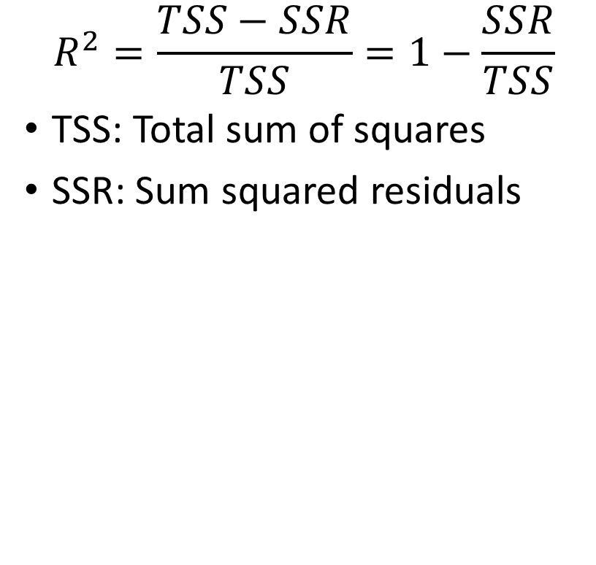
Goodness of fit
$$R^{2}=\frac{TSS−SSR}{TSS}=1−\frac{SSR}{TSS}$$
TSS: Total sum of squares
SSR: Sum squared residuals
Inferential statistics

Slide 49
Assumptions
Inferential statistics

Slide 50
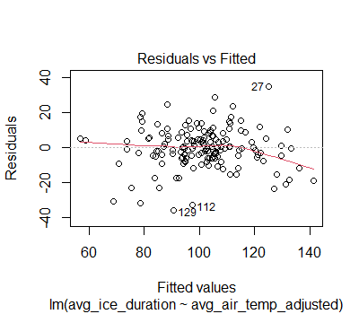
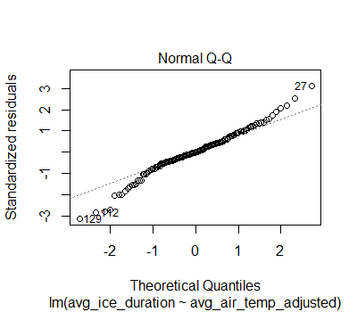
Assumptions
Inferential statistics

Slide 51
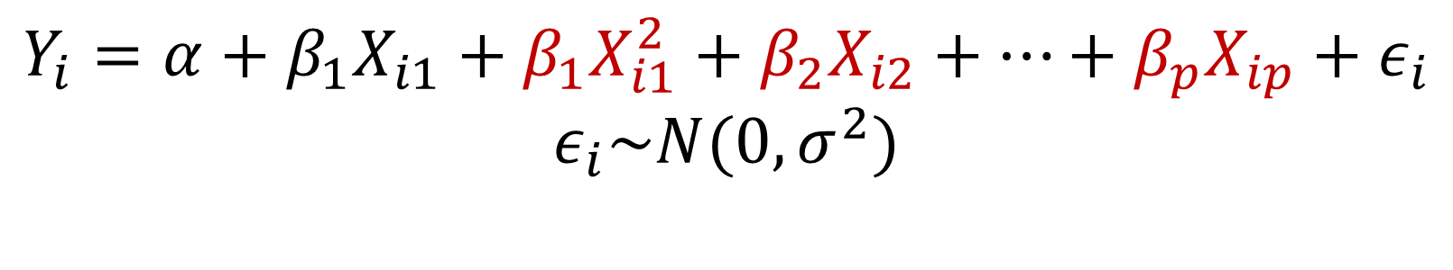
General Linear Regression
$$Y_{i}=α+β_{1}X_{i1}+β_{1}X_{i1}^{2}+β_{2}X_{i2}+…+β_{p}X_{ip}+ε_{i}$$
$$ε_{i}\sim N(0,σ^{2})$$
Example: Gasoline consumption/Distance ~ Car Make + Car Age + Driver Age + Driver Gender + # of breaks per minute + ….
The more the better?
Inferential statistics

Slide 52
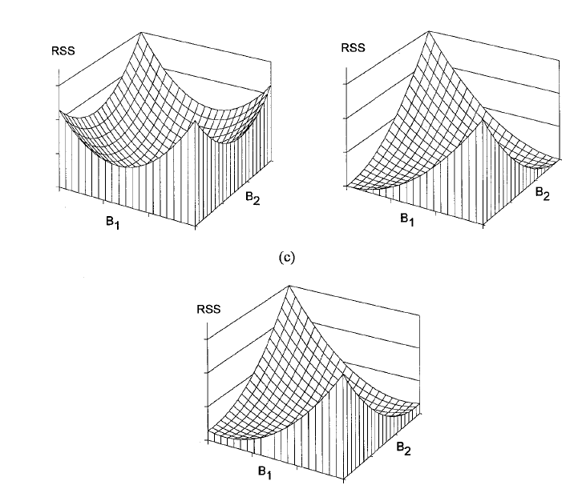
Multicollinearity
Variance Inflation Factor
Inferential statistics

Slide 53
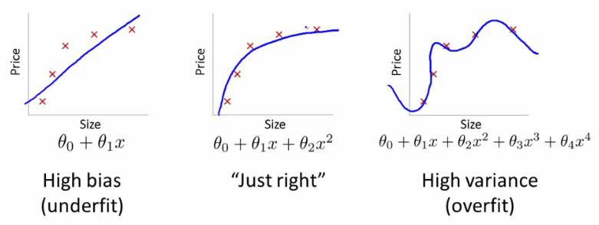
Overfitting vs underfitting
Adjusted R²
AIC
BIC
Predictive power
This Photo by Unknown Author is licensed under CC BY-SA
Inferential statistics

Slide 54

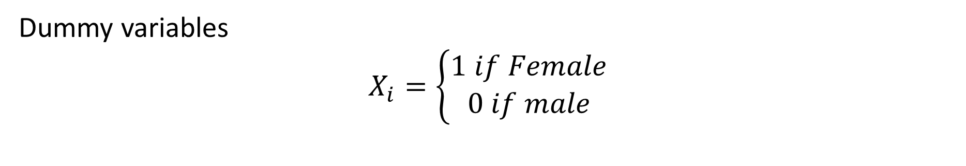


Categorical predictors
Gasoline consumption/Distance ~ Car Make + Car Age + Driver Age + Driver Gender + # of breaks per minute + ….
Dummy variables
$$X_{i}=\left\{\begin{aligned}1 if Female \\ 0 if male\end{aligned}\right.$$
Male: $Y_{i}=α+ε_{i}$
Female: $Y_{i}=α+β_{1}+ε_{i}$
Inferential statistics

Slide 55
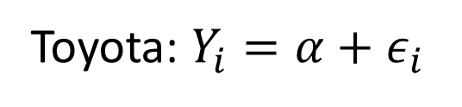
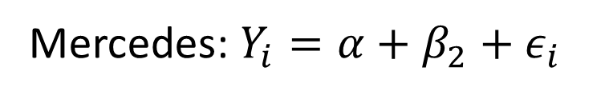
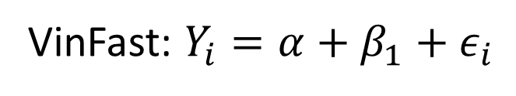



Categorical predictors
Gasoline consumption/Distance ~ Car Make + Car Age + Driver Age + Driver Gender + # of breaks per minute + ….
Dummy variables (Toyota, VinFast, Mercedes)
$$X_{i1}=\left\{\begin{aligned}1 if VinFast \\ 0 if other\end{aligned}\right.$$
$$X_{i2}=\left\{\begin{aligned}1 if Mercedes \\ 0 if other\end{aligned}\right.$$
$$Y_{i}=α+β_{1}X_{i1}+β_{2}X_{i2}+ε_{i}$$
Toyota: $Y_{i}=α+ε_{i}$
VinFast: $Y_{i}=α+β_{1}+ε_{i}$
Mercedes: $Y_{i}=α+β_{2}+ε_{i}$
Inferential statistics

Slide 56
Advanced topics in quantitative methods

Slide 57
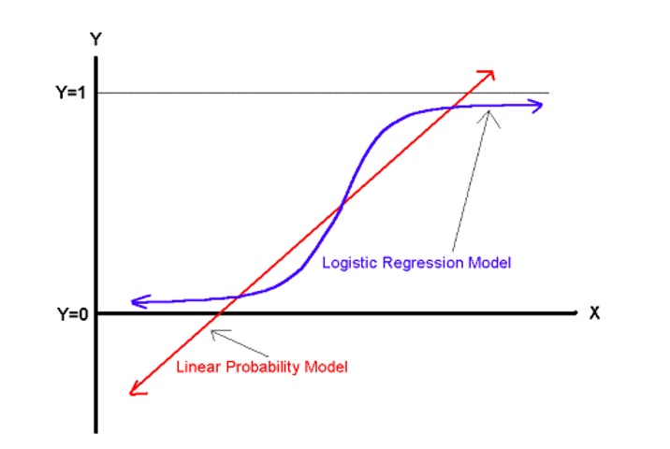
Generalized linear model
General linear regression
Y: continuous/quantitative
When Y is qualitative/discrete?
Binary (Yes/No): Logistic regression
Nominal: Multinominal logistic regression
Count data: Poisson regression
What is data and how to collect?

Slide 58
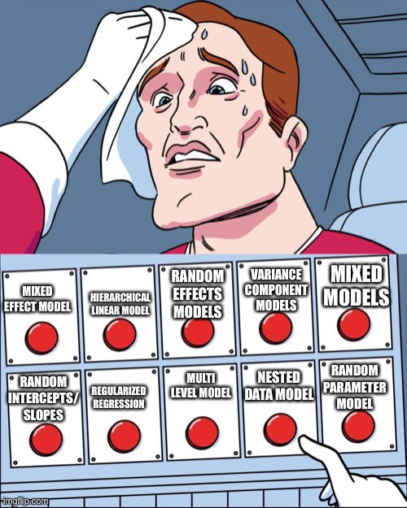
Multilevel model/Mixed effect model
Site 1
Site 2
Location 1
Location 2
Location 3
Location 1
Location 2
Location 3
School 1
School 2
Class 1
Class 2
Class 3
Class 1
Class 2
Class 3
Student 1
Student 2
…
Image by Chelsea Parlett-Pelleriti
What is data and how to collect?

Slide 59

Multilevel model/Mixed effect model
What is data and how to collect?
Image by Chelsea Parlett-Pelleriti

Slide 60
Multilevel model/Mixed effect model
What is data and how to collect?
Image by Chelsea Parlett-Pelleriti

Slide 61
Multilevel model/Mixed effect model
What is data and how to collect?
Image by Chelsea Parlett-Pelleriti

Slide 62
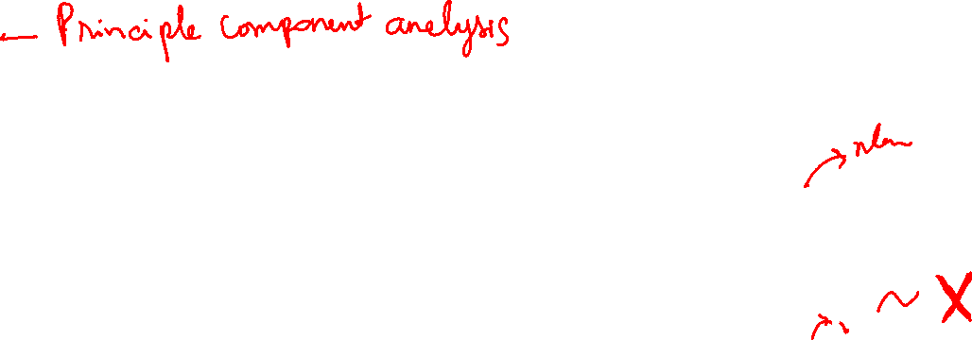
PCA
Multidimensional reduction method
No dependent/independent variables
Exploratory method
PCA – linear regression
Y1
Y2
Y3
C1
Y4
Y5
Y6
C2
Y7
Y8
What is data and how to collect?

Slide 63
Factor Analysis
Latent constructs
Questionnaires
Exploratory/Confirmatory
e1
I1
e2
I2
C1
e3
I3
e4
I4
e5
I5
e6
I6
C2
e7
I7
e8
I8
What is data and how to collect?

Slide 64
SEM
e8
b38
e5
Latent vs manifest
Endogenous vs exogenous
Measurement model vs structural model
Direct vs indirect effects
Age
Threat
b39
e6
b40
e7
Religious
e4
Gender
c13
c14
c15
e1
e2
e3
What is data and how to collect?

Slide 65
SEM
e8
b38
e5
Latent vs manifest
Endogenous vs exogenous
Measurement model vs structural model
Direct vs indirect effects
Age
Threat
b39
e6
b40
e7
Religious
e4
Gender
c13
c14
c15
e1
e2
e3
What is data and how to collect?

Slide 66
Meta Analysis
What is data and how to collect?

